Slide 1
Active Data http://activedata.allizom.org
Kyle Lahnakoski
Engineering Productivity
(formerly Auto-Tools Team)
…but still the “A Team”

Slide 2
Objective
Data driven decision making
Defining metrics and tracking progress
Comparing current state to past performance

Slide 3
Data Warehouse
a copy of transaction data specifically
structured for query and analysis
-- Ralph Kimball
If you have to wait minutes or hours for a question
to be answered, you simply can’t iterate on
hypotheses and investigate in a meaningful way.
-- Jeffrey Wang (just someone on internet*)
* https://amplitude.com/blog/2015/08/25/scaling-analytics-at-amplitude/

Slide 4
Data Warehouse
Fast data access
Reduce effort to get data
Offset query load from transactional systems
Standardize data
Comprehensive single source
Share data

Slide 5
Data Warehouse
Fast data access
Reduce effort to get data
Offset query load from transactional systems
Standardize data
Comprehensive single source
Share data
Supporting ad hoc reporting and charts
Allow quick exploration and discovery
Spark new types of analysis

Slide 6
Data Warehouse
Fast data access
Reduce effort to get data
Offset query load from transactional systems
Standardize data
Comprehensive single source
Share data
Eliminate log parsing
Reduce time to find needles in haystack
No database schema to declare
No indexing or caching for speed

Slide 7
Data Warehouse
Fast data access
Reduce effort to get data
Offset query load from transactional systems
Standardize data
Comprehensive single source
Share data
Report queries often require expensive joins
Long time series demand lots of data

Slide 8
Data Warehouse
Fast data access
Reduce effort to get data
Offset query load from transactional systems
Standardize data
Comprehensive single source
Share data
Standard naming convention
Common dimensions and lookup tables
Identical format

Slide 9
Data Warehouse
Fast data access
Reduce effort to get data
Offset query load from transactional systems
Standardize data
Comprehensive single source
Share data
Data from multiple systems in single location

Slide 10
Data Warehouse
Fast data access
Reduce effort to get data
Offset query load from transactional systems
Standardize data
Comprehensive single source
Share data
Enable others for increased mindshare
Do not block because data is inaccessible
No web service setup
No production services

Slide 11
Data Warehouse
Active Data
Fast data access
Reduce effort to get data
Offset query load from transactional systems
Standardize data
Comprehensive single source
Share data

Slide 12
Active Data
3 billion test results, query response in under a minute
Speed limited by response volume (of course)
Eg “Byte count of structured logs from August” less than 3 seconds
Fast data access
Reduce effort to get data
Offset query load from transactional systems
Standardize data
Comprehensive single source
Share data

Slide 13
Active Data
Fast data access
Reduce effort to get data
Offset query load from transactional systems
Standardize data
Comprehensive single source
Share data
Query language to request data
Summarize with aggregates
Focus on particular features with filters
Pull the raw records

Slide 14
Active Data
Fast data access
Reduce effort to get data
Offset query load from transactional systems
Standardize data
Comprehensive single source
Share data
Use `repo` as a cache of hg.mozilla.org
MoDevMetrics (ActiveData precursor) holds historical bug data for trending dashboards

Slide 15
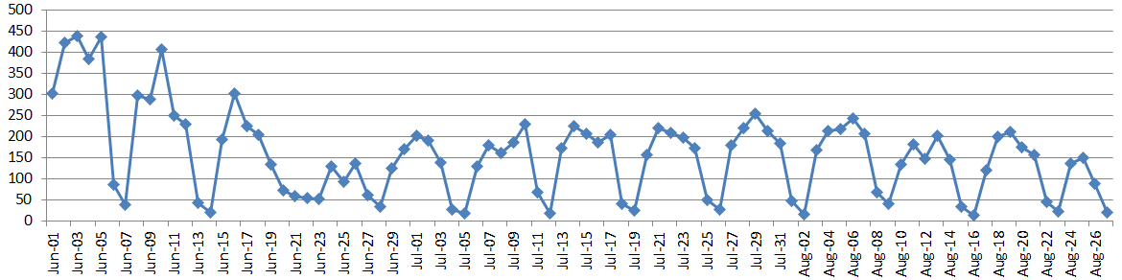
Active Data
New changesets per day over past 3 months (4sec)
Fast data access
Reduce effort to get data
Offset query load from transactional systems
Standardize data
Comprehensive single source
Share data
Use `repo` as a cache of hg.mozilla.org
BugzillaES (ActiveData precursor)

Slide 16
Active Data
Fast data access
Reduce effort to get data
Offset query load from transactional systems
Standardize data
Comprehensive single source
Share data
Uses pulsetranslator for normalized build properties
hg.mozilla.org changeset metadata added to all results

Slide 17
Active Data
Fast data access
Reduce effort to get data
Offset query load from transactional systems
Standardize data
Comprehensive single source
Share data
Unit test structured logs
Mercural repo
Buildbot properties
Orangefactor
Talos performance metrics
Bugzilla?
Treeherder?

Slide 18
Active Data
Fast data access
Reduce effort to get data
Offset query load from transactional systems
Standardize data
Comprehensive single source
Share data
curl http://activedata.allizom.org/query -X POST -d "{\"from\":\"unittest\"}"

Slide 19
Active Data
What is it?
In-memory
everything indexed
columar datastore
for JSON documents
with a query interface
ElasticSearch!
+ query translator

Slide 20
Contents
Unit test results (2 months, 2 billion test results)
Mercural repo
Buildbot properties
Orange Factor
Talos performance metrics
Bugzilla?
Treeherder?

Slide 21
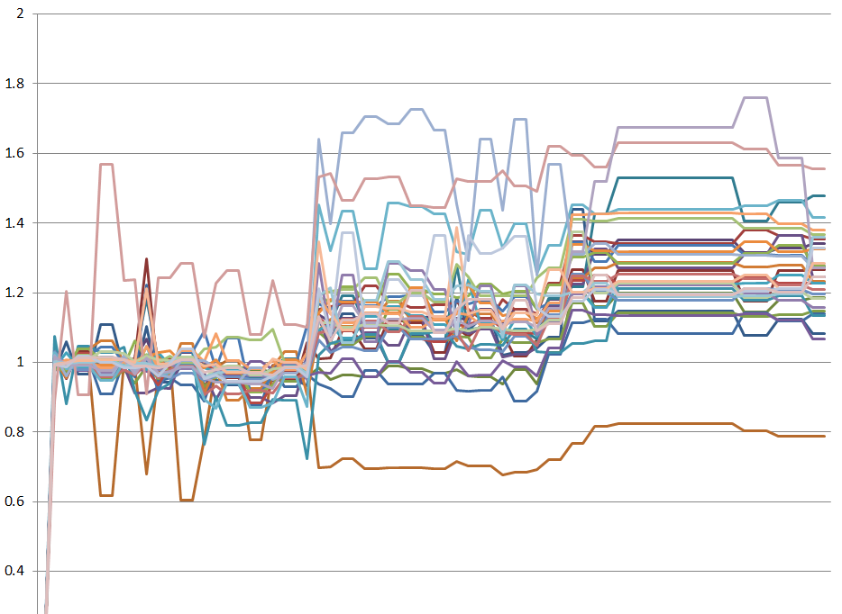
Examples
Identify change in test times
* ActiveData does not include visualization a this time

Slide 22
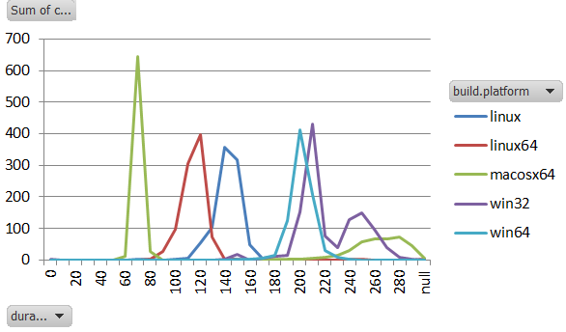
Examples
Identify change in test times
Test-time distributions
* ActiveData does not include visualization a this time

Slide 23
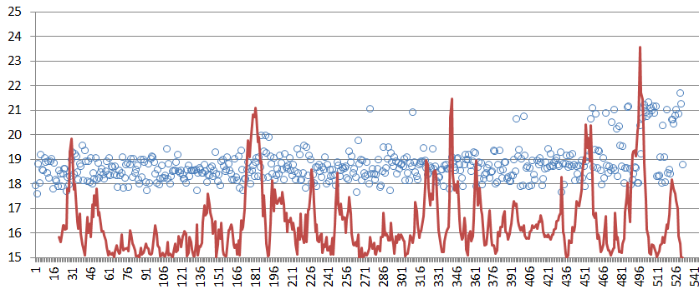
Examples
Identify change in test times
Test time distributions
Visualize perf regression
* ActiveData does not include visualization a this time

Slide 24
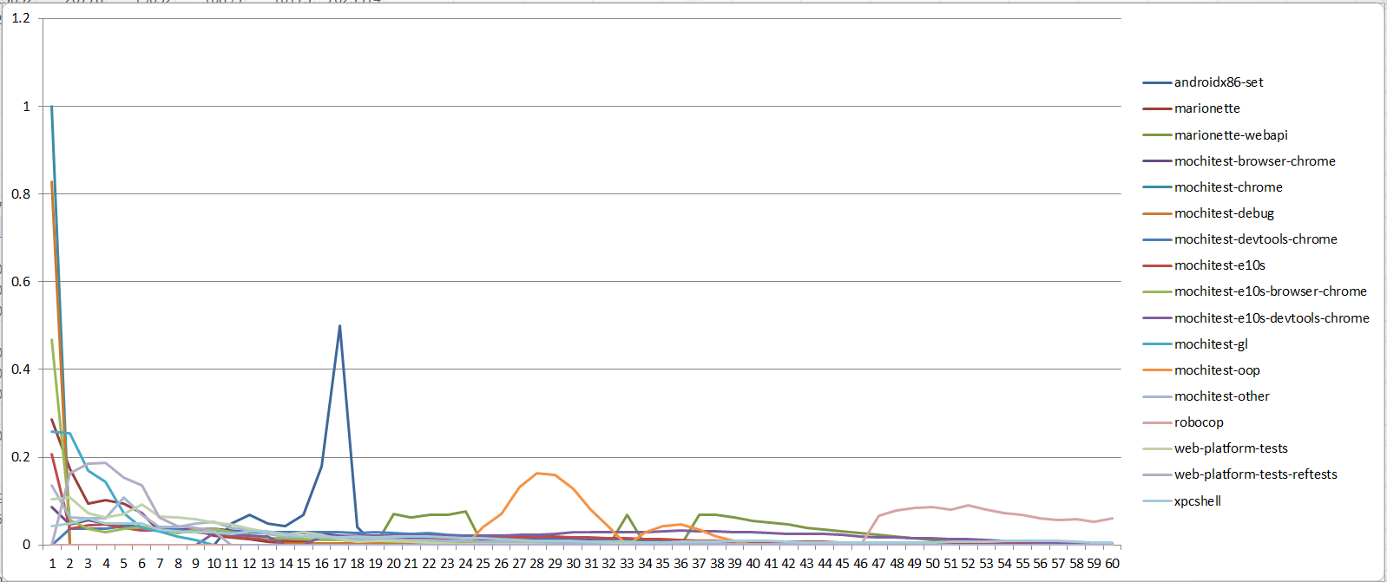
Examples
Identify change in test times
Test time distributions
Visualize perf regression
Fail rate by time into suite
* ActiveData does not include visualization a this time

Slide 25
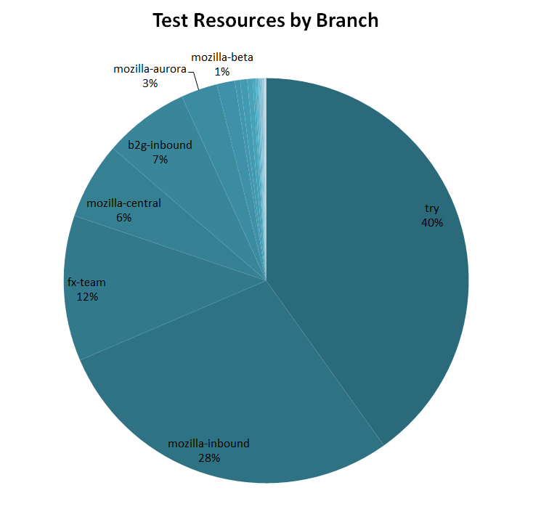
Examples
Identify change in test times
Test time distributions
Visualize perf regression
Fail rate by time into suite
CPU time by Branch
* ActiveData does not include visualization a this time

Slide 26
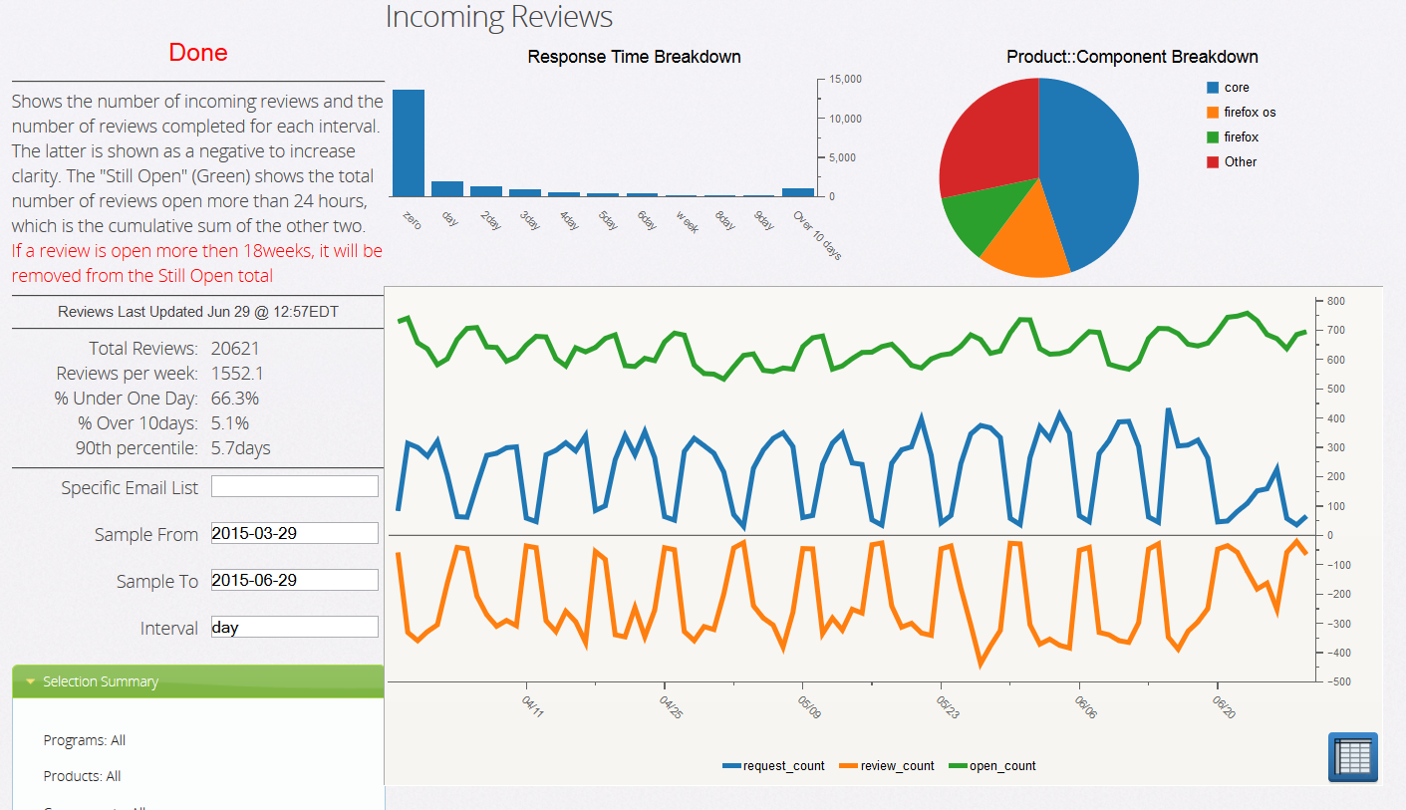
Examples
Identify change in test times
Test time distributions
Visualize perf regression
Fail rate by time into suite
CPU time by branch
Reviews over time*
* From MoDevMetrics, the ActiveData precursor

Slide 27
Limitations
Query language is still limited, complex analysis must be done on client
Not designed for complex relations: Only transactional data; data with little or no lifecycle; can be modeled well.
Data is dumb: Must make the effort to explore the results and avoid misinterpreting the data.

Slide 28
More Details
Query Tool
Service Endpoint
Wiki
Code
http://activedata.allizom.org/tools/query.html
http://activedata.allizom.org/query
https://wiki.mozilla.org/Auto-tools/Projects/ActiveData
https://github.com/klahnakoski/ActiveData

Slide 29
Active Data http://activedata.allizom.org
Kyle Lahnakoski
klahnakoski@mozilla.com

